Slide 1


Name- Sathvik Shetty
Predictive Modelling and Analysis of Airfare trends & Ticket Pricing
Batch- Master in Data Science and AI

Slide 2

Content
Introduction
Problem Statement
Tools
Data Overview
Data Preprocessing
Model Selection and Training
Model Evaluation
Conclusion

Slide 3
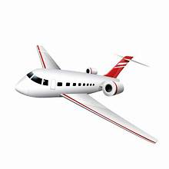
Introduction
The airline industry is highly competitive, with airfare pricing being a critical factor in determining market share and revenue.
Airfare prices are influenced by various factors, including demand, seasonality, fuel prices, and economic conditions.
Accurate airfare forecasting and pricing strategies can significantly impact an airline's bottom line and customer satisfaction.

Slide 4
Problem Statement
Airfare prices fluctuate rapidly, making it challenging for airlines and travel agencies to anticipate and optimize ticket pricing.
Existing airfare pricing models often rely on simplistic approaches, failing to account for complex interactions between factors.
Inaccurate airfare forecasting can result in lost revenue, missed opportunities, and dissatisfied customers, emphasizing the need for a more sophisticated predictive modelling approach.

Slide 5
Tools
Python
Jupyter Notebook
Pandas
NumPy
scikit-learn
Matplotlib
Seaborn
scikit-learn metrics (for model evaluation)

Slide 6
Data Overview
Dataset: Airline Flight Data
Size: 10,684 Booked Ticked
Variables: 11
The depended variable in this project is: Price

Slide 7
Data Preprocessing
Dropped Additional_Info Feature.
Outlier detection – Most of the features are Categorical.
Feature Engineering
Date of Journey- Day, Month, Year.
Day- Weekend or not.
Total Stops- Route type i.e Direct or Connecting
Duration Hours- 'less than 3hrs’ , 'between 3hrs to 8hrs’ , 'between 8hrs to 24hrs’ , 'more than 1day'

Slide 8
Contd
Dep_Time
6am <= Dep_Time < 12pm – Morning
12pm <= Dep_Time < 5pm – Afternoon
5pm <= Dep_Time < 9pm – Evening
9pm> - Night
Handle Categorical Feature using Label Encoder.

Slide 9
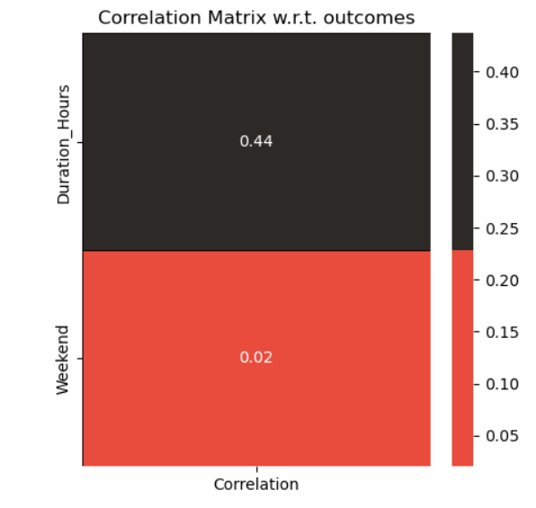
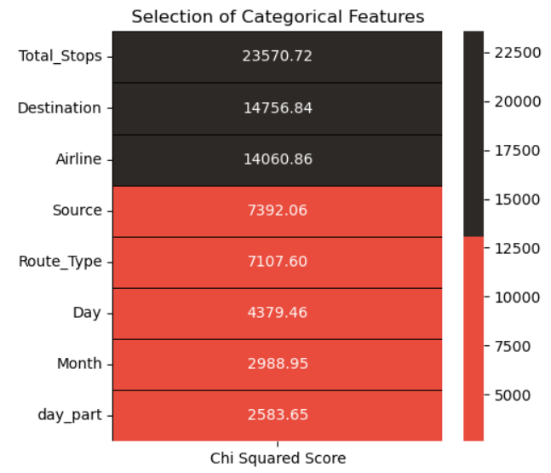
Contd
Feature Importance
Total_Stops,Destination and Airline.
Duration_Hours
is the most significant factor in predicting Price, according to statistical tests

Slide 10
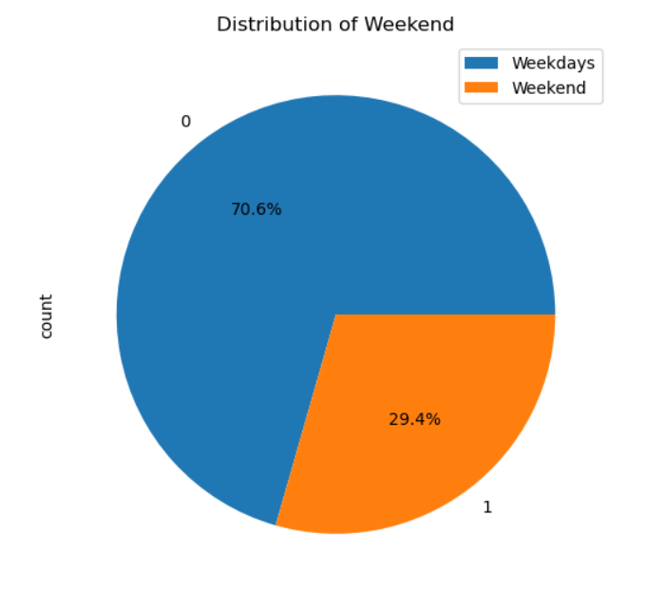
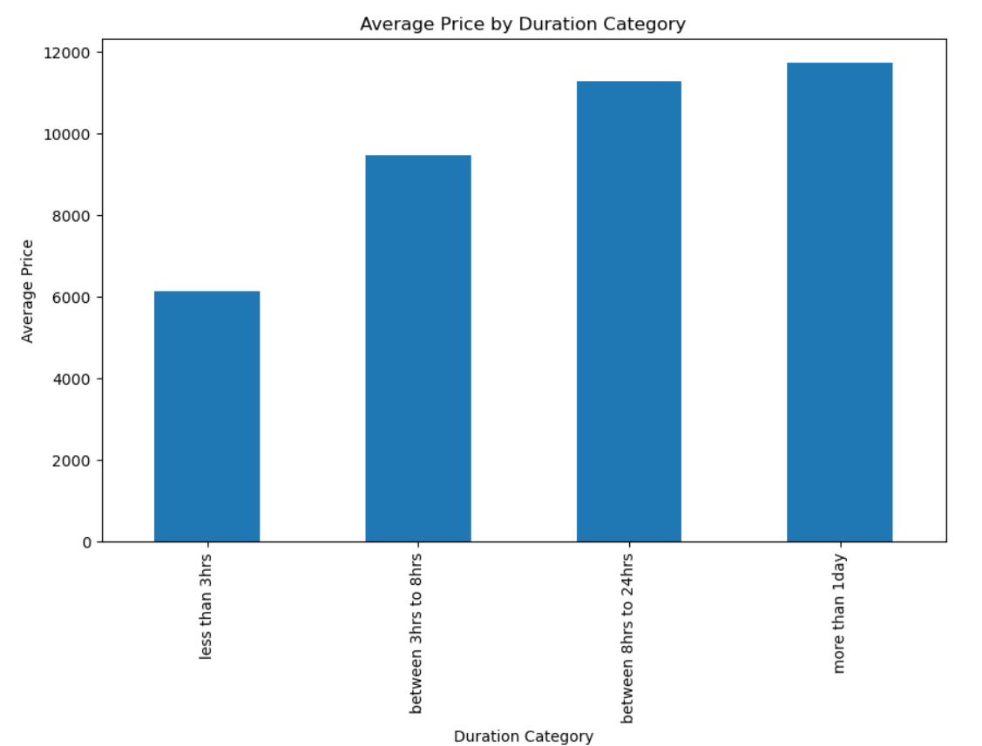
Contd

Slide 11
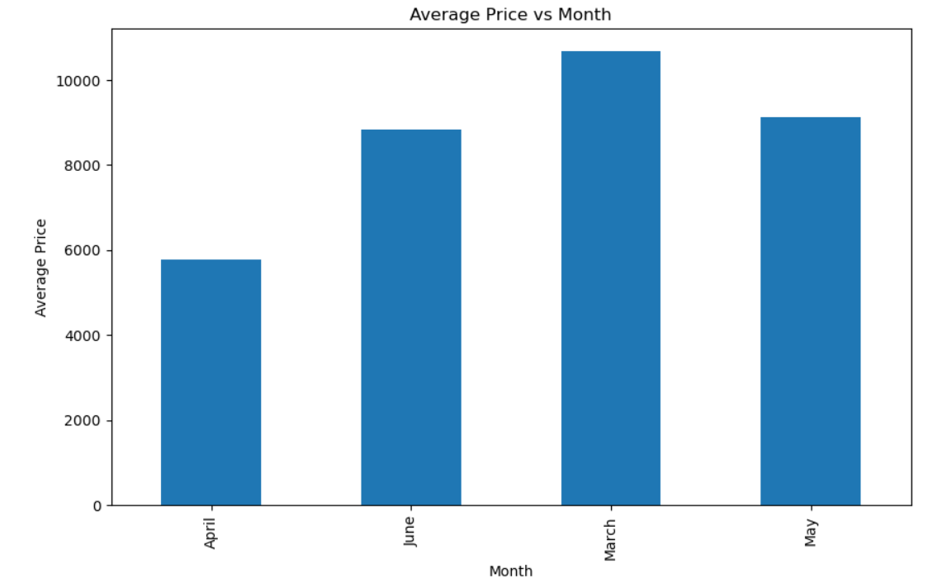
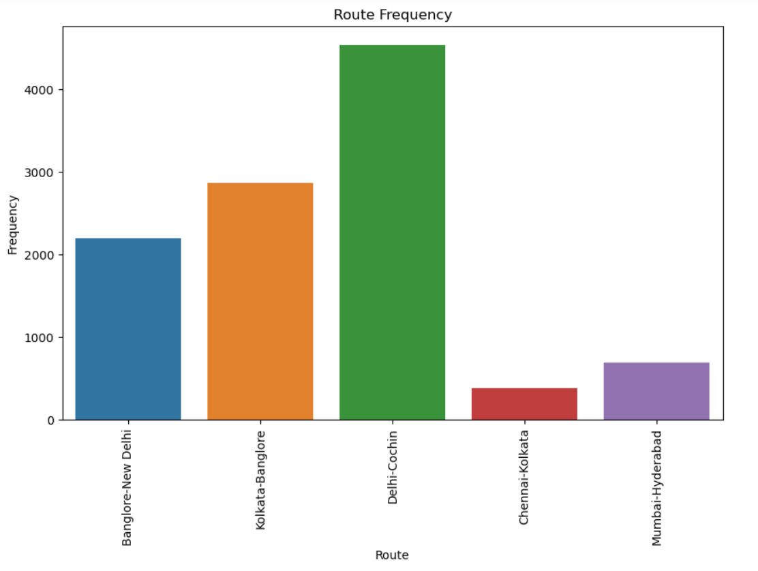
Contd

Slide 12
Model Selection and Training
Model:
Linear Regression
Random Forest Regressor
Gradient Boosting Regressor
Decision Tree Regressor
Training:
Split data into training (70%) and testing sets (30%)
Train the model on the training set

Slide 13


Model Evaluation
Training Result
Testing Result

Slide 14
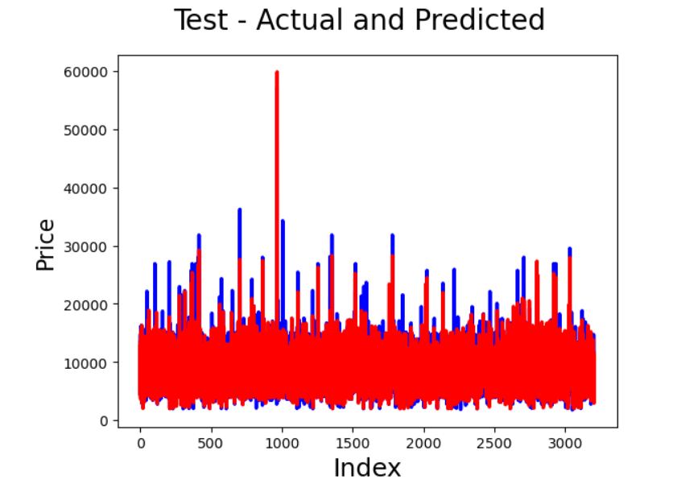
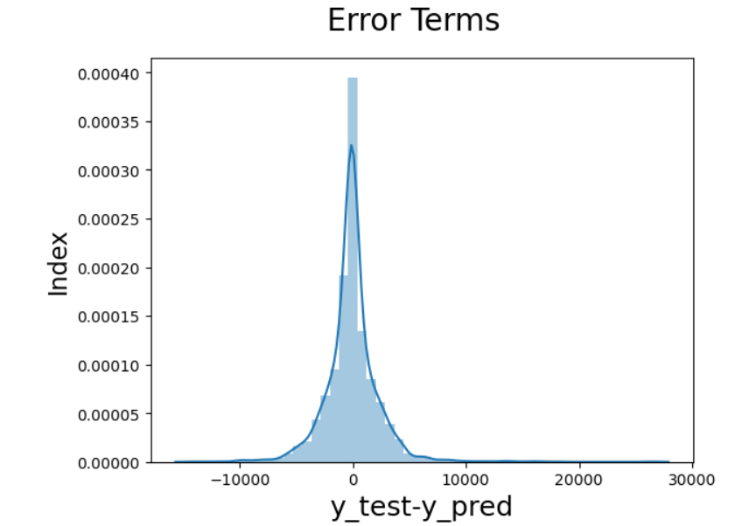
Overall, the Random Forest and Decision Tree models perform well, but show signs of slight overfitting. The Gradient Boosting model has stable performance, while the Linear Regression model underfits the data.

Slide 15
Utilized Random Forest Model for airfare price prediction
Conducted hyperparameter tuning to optimize model performance
Performed cross-validation to prevent overfitting and underfitting

Slide 16
Conclusion
Key Takeaways:
Airfare prices can be predicted with high accuracy using historical data, seasonal trends, and external factors.
Demand, seasonality, and fuel prices drive airfare prices.
Our model informs ticket pricing and travel planning decisions.
Benefits:
Improved revenue management through optimized pricing strategies.
Enhanced customer satisfaction through personalized pricing and offers.

Slide 17
THANK YOU

